Slide 1
Textual Relations Annotator
StARLinG Labs
Abhiramon Rajasekharan

Slide 2
Index
Objective
Implementation
Demo
Future extensions

Slide 3
Objectives
Allow user to upload train and test documents to interface.
Display documents and allow selection of text as positive examples.
Convert documents and positive examples to predicates format.
Train Boost-SRL model (using all stored documents)
Test the model and display test results in color-coded format

Slide 4
Implementation

Slide 5
Features implemented
Uploaded files are displayed, positive examples can be selected using GUI (web interface).
Text document and positive examples are converted into predicates (using rnlp python module).
Appropriate files are created, model training and testing is done using Boost-SRL software (using shell commands).
Results after testing are extracted and displayed in color-coded format on results page.
Program can be run in computers with Windows OS.

Slide 6
Softwares used
Python 2, python libraries: Flask, rnlp, os, sys
HTML
CSS
Java Script
Shell commands
Boost SRL package (https://starling.utdallas.edu/software/boostsrl/)

Slide 7
Demo

Slide 8
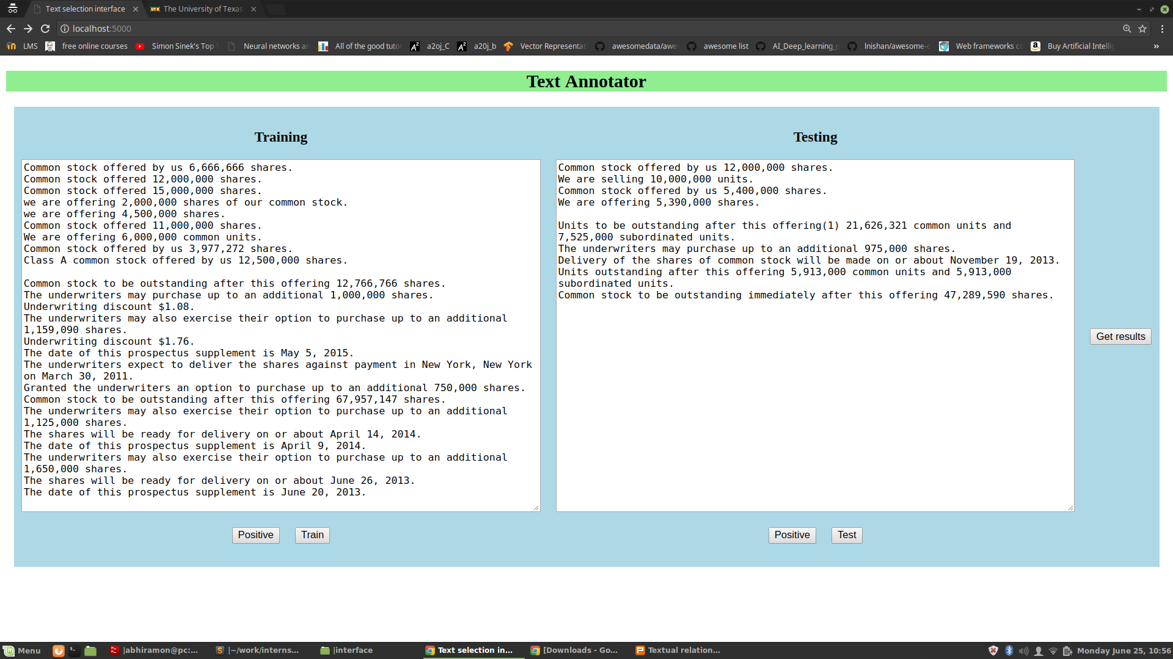

Slide 9
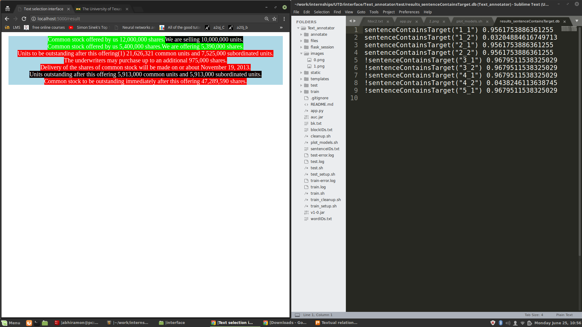

Slide 10
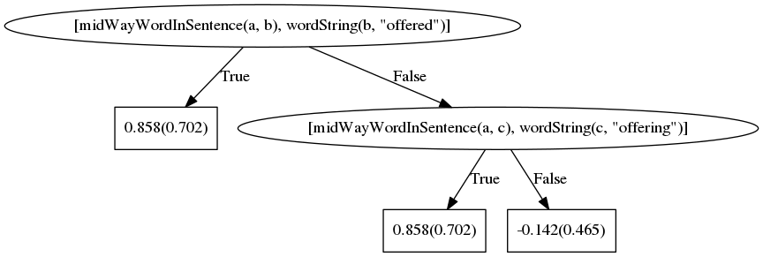
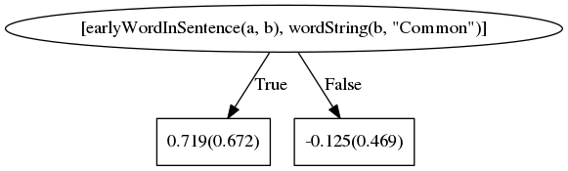

Slide 11
Future extensions
Backend with database for storing positive examples and documents (can be extended using SQLAlchemy python library)
GUI can be improved using React JS

